Slide 1
Two-Way Independent ANOVA (GLM 3)
Prof. Andy Field

Slide 2
Aims
Rationale of Factorial ANOVA
Partitioning Variance
Interaction Effects
Interaction Graphs
Interpretation

Slide 3
What is Two-Way Independent ANOVA?
Two Independent Variables
Two-way = 2 Independent variables
Three-way = 3 Independent variables
Different participants in all conditions.
Independent = ‘different participants’
Several Independent Variables is known as a factorial design

Slide 4
Benefit of Factorial Designs
We can look at how variables Interact.
Interactions
Show how the effects of one IV might depend on the effects of another
Are often more interesting than main effects.
Examples
Interaction between hangover and lecture topic on sleeping during lectures.
A hangover might have more effect on sleepiness during a stats lecture than during a clinical one.

Slide 5
An Example
Field (2013): Testing the effects of Alcohol and Gender on ‘the beer-goggles effect’:
IV 1 (Alcohol): None, 2 pints, 4 pints
IV 2 (Gender): Male, Female
Dependent Variable (DV) was an objective measure of the attractiveness of the partner selected at the end of the evening.

Slide 8
Step 1: Calculate SS_{T}

Slide 9
Step 2: Calculate SS_{M}

Slide 10
Step 2a: Calculate SS_{A}
A₁: Female |  |  |  | A₂: Male
65 | 70 | 55 |  | 50 | 45 | 30
70 | 65 | 65 |  | 55 | 60 | 30
60 | 60 | 70 |  | 80 | 85 | 30
60 | 70 | 55 |  | 65 | 65 | 55
60 | 65 | 55 |  | 70 | 70 | 35
55 | 60 | 60 |  | 75 | 70 | 20
60 | 60 | 50 |  | 75 | 80 | 45
55 | 50 | 50 |  | 65 | 60 | 40
Mean Female = 60.21 |  |  |  | Mean Male = 56.46

Slide 11
Step 2b: Calculate SS_{B}
B₁: None |  |  | B₂: 2 Pints |  |  | B₃: 4 Pints
65 | 50 |  | 70 | 45 |  | 55 | 30
70 | 55 |  | 65 | 60 |  | 65 | 30
60 | 80 |  | 60 | 85 |  | 70 | 30
60 | 65 |  | 70 | 65 |  | 55 | 55
60 | 70 |  | 65 | 70 |  | 55 | 35
55 | 75 |  | 60 | 70 |  | 60 | 20
60 | 75 |  | 60 | 80 |  | 50 | 45
55 | 65 |  | 50 | 60 |  | 50 | 40
Mean None = 63.75 |  |  | Mean 2 Pints = 64.6875 |  |  | Mean 4 Pints = 46.5625

Slide 12
Step 2c: Calculate SS_{A × B}

Slide 13
Step 3: Calculate SS_{R}
Notes:
The residual sum of squares is calculated in the same way as for one-way ANOVA and again represents individual differences in performance or the variance that can’t be explained by factors that were systematically manipulated. We saw in one-way ANOVA that the value is calculated by taking the squared error between each data point and its corresponding group mean. An alternative way to express this was as in equation 1 in the slide.
So, we use the individual variances of each group and multiply them by one less than the number of people within the group (n). We have the individual group variances in our original table of data (first page of this handout) and there were 8 people in each group (therefore, n = 8) and so the equation becomes the second equation on the slide.
The degrees of freedom for each group will be one less than the number of scores per group (i.e. 7). Therefore, if we add the sums of squares for each group, we get a total of 6 × 7 = 42.

Slide 14
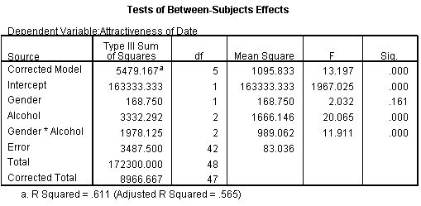
Summary Table

Slide 15
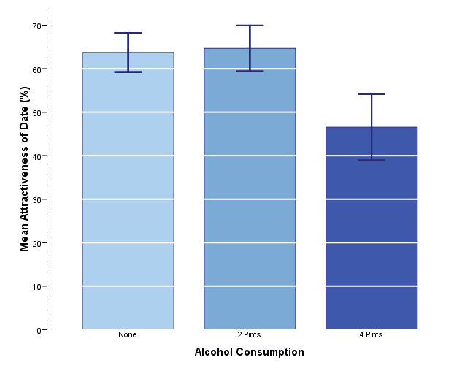
Interpretation: Main Effect Alcohol
There was a significant main effect of the amount of alcohol consumed at the night-club, on the attractiveness of the mate that was selected, F(2, 42) = 20.07, p < .001.

Slide 16
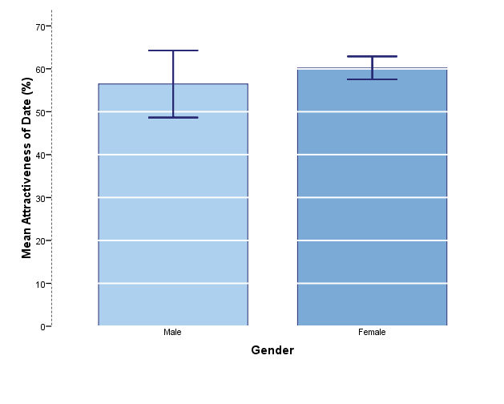
Interpretation: Main Effect Gender
There was a nonsignificant main effect of gender on the attractiveness of selected mates, F(1, 42) = 2.03, p = .161.

Slide 17
Interpretation: Interaction
There was a significant interaction between the amount of alcohol consumed and the gender of the person selecting a mate, on the attractiveness of the partner selected, F(2, 42) = 11.91, p < .001.
Notes:
The interaction shows non-parallel lines. That is for low does of alcohol male and female scores do not change much. At a high dose (4 pints) male scores plummet but female scores remain fairly high. So, the interaction is caused by a difference between males and females in the effect of alcohol.

Slide 18
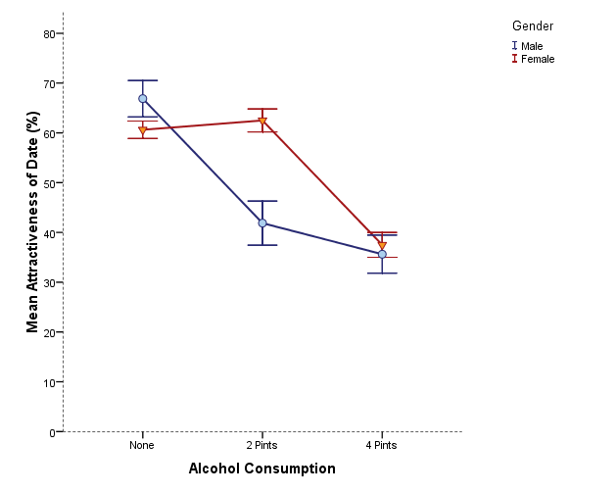
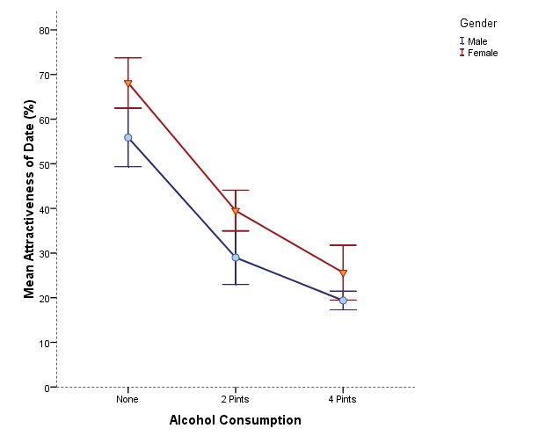
Is there likely to be a significant interaction effect?
Yes
No

Slide 19
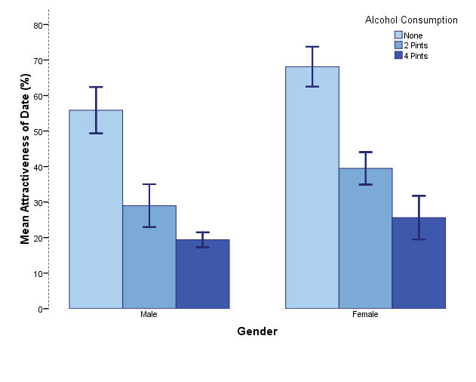
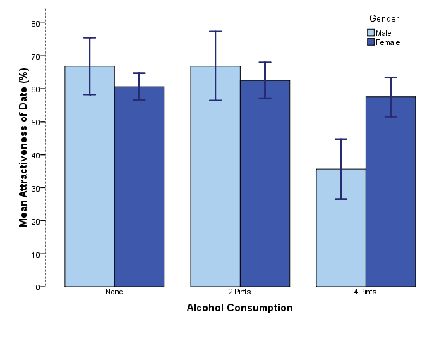
Is there likely to be a significant interaction effect?
No
Yes

